Slide 1
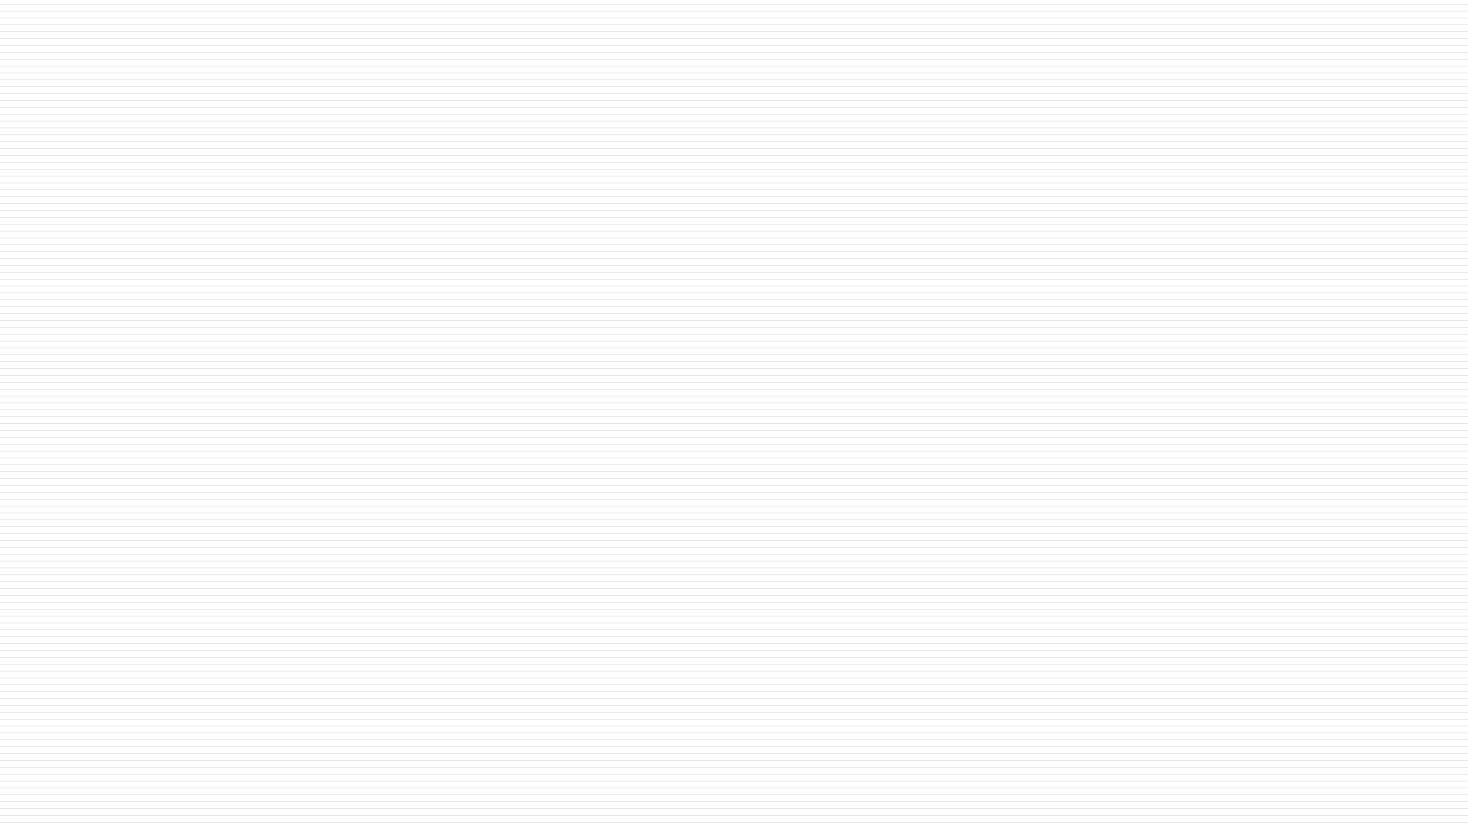

Department of Artificial Intelligence and Data Science
TITLE
Telecommunications--Usage Behavior Segmentation
RITHIKA SMITHI 231801138
SANDHYA SREE 231801146
SASI SRIRAM 231801159
<Supervisor Name
with Designation>

Slide 2
Problem Statement and Motivation
Problem Statement
Telecom companies collect massive user data, but lack effective behavior-based segmentation, leading to poor personalization and customer retention.
Motivation
Using data analytics and machine learning, telecom providers can identify user patterns to personalize services, predict churn, and improve satisfaction.

Slide 3
Existing System
Existing System
Current Situation:
Most telecom providers use basic demographic segmentation (like age, location, income).
Manual or rule-based methods don’t capture actual user behavior.
As a result:
  Marketing strategies are generic,
  Customer engagement is low, and
  Retention programs are ineffective.

Slide 4
Objectives
To analyze telecom usage data and identify behavior-based customer segments.
To predict customer churn (customers likely to leave).
To recommend personalized plans or offers for different user types.
To help telecom providers optimize marketing and increase satisfaction.

Slide 5
Abstract
This project applies data analytics and clustering techniques to segment telecom users based on their real usage patterns of calls, data, and SMS.
By identifying distinct behavior groups, telecom companies can personalize offers, predict churn, and improve customer satisfaction through data-driven insights.
The model helps in optimizing marketing strategies and ensuring better resource utilization.
Overall, it enables telecom providers to make smarter, customer-centric, and profit-oriented decisions.

Slide 6
Thank You

